Slide 1
Software Engineering(BIS/CSSE404)
1. Ian Sommerville: Software Engineering, 10th Edition, Pearson Education, 2017.
2. Paul C. Jorgensen: Software Testing - A Craftsman’s Approach, Fourth Edition, Auerbach Publications.
3. Bob Hughes, Mike Cotterell, Rajib Mall: Software Project Management, 6th Edition, McGraw Hill Education, 2018.

Slide 2
MODULE 1
Content:
Introduction: Professional Software Development, Software Engineering Ethics. Case Studies.
Software Processes Models: Software process models. Process activities. Coping with Change.
Agile Software Development: Agile methods. Agile development techniques. Agile project management. Scaling agile methods.

Slide 3
What is software?
A software system usually consists of a number of separate programs, configuration files, system documentation, and user documentation. There are two fundamental types of software product:
Generic products: These are stand-alone systems that are produced by a development organization and sold on the open market to any customer who is able to buy them. Eg: MS word, Windows XP etc
Customized (or bespoke): These are systems which are commissioned by a particular customer. A software contractor develops the software especially for that customer. Eg: Bank management, Office automation etc

Slide 4
What is software engineering?
Software engineering is an engineering discipline that is concerned with all aspects of software production from the early stages of system specification to maintaining the system after it has gone into use.
Software engineering is the application of a systematic, disciplined, quantifiable approach to the development, operation and maintenance of software.

Slide 5
Software Engineering provides a set of:
Procedures: defines what are the activities and when they will be executed bind the methods and tools into a framework.
Methods: defines How each activity is executed using the technology provide the rules and steps for carrying out software engineering tasks, such as project planning, requirements analysis, design, coding, testing and maintenance.
Tools: provide automated or semi-automated support for methods. Tools that automates a range of software engineering methods, called Computer-Aided Software Engineering (CASE).

Slide 6
Contd..
What's the difference between software engineering and computer science?
Computer science is concerned with the theories and methods that underlie computers and software systems
While Software engineering is concerned with the practical problems of producing software
What is the difference between software engineering and system engineering?
System engineering is concerned with all aspects of the development and evolution of complex systems i.e manufacturing a product
While Software engineering is concerned with the practical problems of producing software i.e developing software

Slide 7
What is a software process?
A software process is the set of activities and associated results that produce a software product. There are four fundamental process activities:
Software specification where customers and engineers define the software to be produced and the constraints on its operation
Software development where the software is designed and programmed
Software validation where the software is checked to ensure that it is what the customer requires
Software evolution where the software is modified to adapt it to changing customer and market requirements

Slide 8
Contd..
What is a software process model?
A software process model is a simplified description of a software process; different process models depict different arrangement of the process activities.
What are the costs of software engineering?
The distribution of costs across the different activities in the software process depends on the process used and the type of software that is being developed. Roughly 60% of costs are development costs, 40% are testing costs
What are software engineering methods?
Defines How each activity is executed using the technology provide the rules and steps for carrying out software engineering tasks, such as project planning, requirements analysis, design, coding, testing and maintenance

Slide 9
What is CASE
It covers a wide range of different types of tools that are used to support software process activities such as requirements analysis, system modeling, debugging and testing.
What are the attributes of good software?
Maintainability: Software must evolve to meet changing needs
Dependability: Software must be trustworthy, reliable
Efficiency: Software should not make wasteful use of system resources
Usability: Software must be usable by the users for which it was designed

Slide 10
What are the key challenges facing software engineering?
The heterogeneity challenge: Increasingly, systems are required to operate as distributed systems across networks that include different types of computers and with different kinds of support systems
The delivery challenge: Many traditional software engineering techniques are time-consuming. However, businesses today must be responsive and change very rapidly.
The trust challenge: As software is intertwined with all aspects of our lives, it is essential that we can trust that software.

Slide 11
Professional and ethical responsibility
Software engineers must behave in an ethical and morally responsible way if they are to be respected as professionals some of these are:
Confidentiality: you should normally respect the confidentiality of your employers or clients irrespective of whether a formal confidentiality agreement has been signed.
Competence: you should not misrepresent your level of competence. You should not knowingly accept work that is outside your competence.
Intellectual property rights: you should be aware of local laws governing the use of intellectual property such as patents and copyright. You should be careful to ensure that the intellectual property of employers and clients is protected.
Computer misuse: you should not use your technical skills to misuse other people's computers. Computer misuse ranges from relatively trivial (game playing on an employer's machine, say) to extremely serious (dissemination of viruses).

Slide 12
Software engineers shall adhere to the following Eight Principles:
1. PUBLIC - Software engineers shall act consistently with the public interest.
2. CLIENT AND EMPLOYER - Software engineers shall act in a manner that is in the best interests of their client and employer consistent with the public interest.
3. PRODUCT - Software engineers shall ensure that their products and related modifications meet the highest professional standards possible.
4. JUDGMENT - Software engineers shall maintain integrity and independence in their professional judgment.
5. MANAGEMENT - Software engineering managers and leaders shall subscribe to and promote an ethical approach to the management of software development and maintenance.
6. PROFESSION - Software engineers shall advance the integrity and reputation of the profession consistent with the public interest.
7. COLLEAGUES - Software engineers shall be fair to and supportive of their colleagues.
8. SELF - Software engineers shall participate in lifelong learning regarding the practice of their profession and shall promote an ethical approach to the practice of the profession.

Slide 13
Professional s/w development
Lots of people write programs. People in business write spreadsheet programs to simplify their jobs; scientists and engineers write programs to process their experimental data; hobbyists write programs for their own interest and enjoyment.
However, most software development is a professional activity in which software is developed for business purposes, for inclusion in other devices, or as software products such as information systems and computer-aided design systems.
The key distinctions are that professional software is intended for use by someone apart from its developer and that teams rather than individuals usually develop the software.It is maintained and changed throughout its life.

Slide 14
Contd..
Software engineering is intended to support professional software development rather than individual programming.
It includes techniques that support program specification, design, and evolution, none of which are normally relevant for personal software development.
To help you to get a broad view of software engineering, we have summarized frequently asked questions about the subject in Figure 1.1.

Slide 15
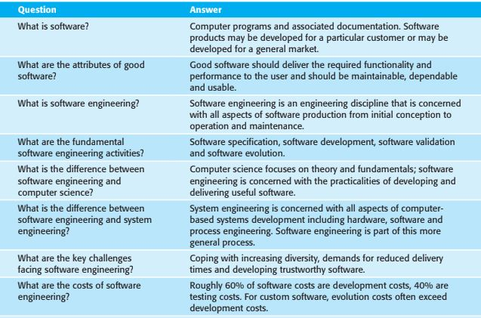
Contd..

Slide 16
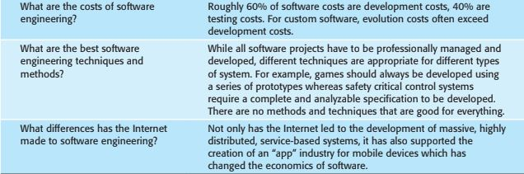
Contd..

Slide 17
Contd..
Many people think that software is simply another word for computer programs.
However, when we are talking about software engineering, software is not just the programs themselves but also all associated documentation, libraries, support web-sites, and configuration data that are needed to make these programs useful.
A professionally developed software system is often more than a single program.
A system may consist of several separate programs and configuration files that are used to setup these programs.
It may include system documentation, which describes the structure of the system, user documentation, which explains how to use the system, and websites for users to download recent product information.

Slide 18
Software engineering
Software engineering is an engineering discipline that is concerned with all aspects of software production from the early stages of system specification through to maintaining the system after it has gone into:
1. Engineering discipline Engineers make things work. They apply theories, methods, and tools where these are appropriate. However, they use them selectively and always try to discover solutions to problems even when there are no applicable theories and methods. Engineers also recognize that they must work within organizational and financial constraints, and they must look for solutions within these constraints.

Slide 19
Contd..
2. All aspects of software production Software engineering is not just concerned with the technical processes of software development. It also includes activities such as software project management and the development of tools, methods, and theories to support software development.

Slide 20
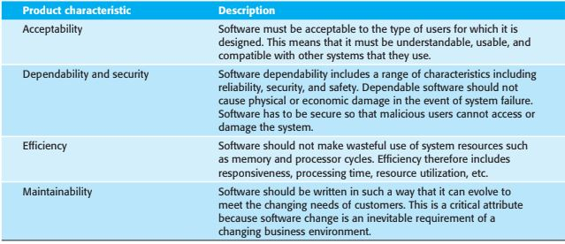
Essential attributes of good software

Slide 21
Contd..
The systematic approach that is used in software engineering is sometimes called a software process. A software process is a sequence of activities that leads to the production of a software product. Four fundamental activities are common to all software processes.
1. Software specification, where customers and engineers define the software that is to be produced and the constraints on its operation.
2. Software development, where the software is designed and programmed.
3. Software validation, where the software is checked to ensure that it is what the customer requires.
4. Software evolution, where the software is modified to reflect changing customer and market requirements.

Slide 22
Contd..
Software engineering is related to both computer science and systems engineering.
1. Computer science is concerned with the theories and methods that underlie computers and software systems, whereas software engineering is concerned with the practical problems of producing software. Some knowledge of computer science is essential for software engineers in the same way that some knowledge of physics is essential for electrical engineers. Computer science theory, however, is often most applicable to relatively small programs. Elegant theories of computer science are rarely relevant to large, complex problems that require a software solution.

Slide 23
Contd..
2. System engineering is concerned with all aspects of the development and evolution of complex systems where software plays a major role. System engineering is therefore concerned with hardware development, policy and process design, and system deployment, as well as software engineering. System engineers are involved in specifying the system, defining its overall architecture, and then integrating the different parts to create the finished system.

Slide 24
Four issues that affect many different types of software:
1. Heterogeneity Increasingly, systems are required to operate as distributed systems across networks that include different types of computer and mobile devices. As well as running on general-purpose computers, software may also have to execute on mobile phones and tablets. You often have to integrate new software with older legacy systems written in different programming languages. The challenge here is to develop techniques for building dependable software that is flexible enough to cope with this heterogeneity.

Slide 25
Contd..
2. Business and social change Businesses and society are changing incredibly quickly as emerging economies develop and new technologies become available. They need to be able to change their existing software and to rapidly develop new software. Many traditional software engineering techniques are time consuming, and delivery of new systems often takes longer than planned. They need to evolve so that the time required for software to deliver value to its customers is reduced.

Slide 26
Contd..
3. Security and trust As software is intertwined with all aspects of our lives, it is essential that we can trust that software. This is especially true for remote software systems accessed through a web page or web service interface. We have to make sure that malicious users cannot successfully attack our software and that information security is maintained.
4. Scale Software has to be developed across a very wide range of scales, from very small embedded systems in portable or wearable devices through to Internet-scale, cloud-based systems that serve a global community.

Slide 27
Software engineering diversity
Software engineering is a systematic approach to the production of software that takes into account practical cost, schedule, and dependability issues, as well as the needs of software customers and producers.
The specific methods, tools, and techniques used depend on the organization developing the software, the type of software, and the people involved in the development process.
There are no universal software engineering methods that are suitable for all systems and all companies.
Rather, a diverse set of software engineering methods and tools has evolved over the past 50 years.
However, the SEMAT initiative (Jacobson et al. 2013) proposes that there can be a fundamental meta-process that can be instantiated to create different kinds of process.
This is at an early stage of development and may be a basis for improving our current software engineering methods.

Slide 28
contd….
There are many different types of application, including:
1. Stand-alone applications These are application systems that run on a personal computer or apps that run on a mobile device. They include all necessary functionality and may not need to be connected to a network. Examples of such applications are office applications on a PC, CAD programs, photo manipulation software, travel apps, productivity apps, and so on.

Slide 29
Contd..
2. Interactive transaction-based applications These are applications that execute on a remote computer and that are accessed by users from their own computers, phones, or tablets. Obviously, these include web applications such as e-commerce applications where you interact with a remote system to buy goods and services. This class of application also includes business systems, where a business provides access to its systems through a web browser or special-purpose client program and cloud-based services, such as mail and photo sharing. Interactive applications often incorporate a large data store that is accessed and updated in each transaction.

Slide 30
Contd..
3. Embedded control systems These are software control systems that control and manage hardware devices. Numerically, there are probably more embedded systems than any other type of system. Examples of embedded systems include the software in a mobile (cell) phone, software that controls antilock braking in a car, and software in a microwave oven to control the cooking process.
4. Batch processing systems These are business systems that are designed to process data in large batches. They process large numbers of individual inputs to create corresponding outputs. Examples of batch systems are periodic billing systems, such as phone billing systems, and salary payment systems.

Slide 31
Contd..
5. Entertainment systems These are systems for personal use that are intended to entertain the user. Most of these systems are games of one kind or another, which may run on special-purpose console hardware. The quality of the user interaction offered is the most important distinguishing characteristic of entertainment systems.
6. Systems for modeling and simulation These are systems that are developed by scientists and engineers to model physical processes or situations, which include many separate, interacting objects. These are often computationally intensive and require high-performance parallel systems for execution.

Slide 32
Contd..
7. Data collection and analysis systems Data collection systems are systems that collect data from their environment and send that data to other systems for processing. The software may have to interact with sensors and often is installed in a hostile environment such as inside an engine or in a remote location. “Big data” analysis may involve cloud-based systems carrying out statistical analysis and looking for relationships in the collected data.
8. Systems of systems These are systems, used in enterprises and other large organizations, that are composed of a number of other software systems. Some of these may be generic software products, such as an ERP system. Other systems in the assembly may be specially written for that environment.

Slide 33
Internet software engineering
The development of the Internet and the World Wide Web has had a profound effect on all of our lives. Initially, the web was primarily a universally accessible information store, and it had little effect on software systems.
These systems ran on local computers and were only accessible from within an organization. Around 2000, the web started to evolve, and more and more functionality was added to browsers.
This meant that web-based systems could be developed where, instead of a special-purpose user interface, these systems could be accessed using a web browser.
This led to the development of a vast range of new system products that delivered innovative services, accessed over the web.
These are often funded by adverts that are displayed on the user’s screen and do not involve direct payment from users.

Slide 34
Contd..
As well as these system products, the development of web browsers that could run small programs and do some local processing led to an evolution in business and organizational software.
Instead of writing software and deploying it on users’ PCs, the software was deployed on a web server.
This made it much cheaper to change and upgrade the software, as there was no need to install the software on every PC.
It also reduced costs, as user interface development is particularly expensive. Wherever it has been possible to do so, businesses have moved to web-based inter- action with company software systems.

Slide 35
Contd..
The advent of the web has led to a dramatic change in the way that business software is organized.
Before the web, business applications were mostly monolithic, single programs running on single computers or computer clusters.
Communications were local, within an organization. Now, software is highly distributed, sometimes across the world.
Business applications are not programmed from scratch but involve extensive reuse of components and programs.
This change in software organization has had a major effect on software engineering for web-based systems. For example:

Slide 36
Contd..
1. Software reuse has become the dominant approach for constructing web-based systems. When building these systems, you think about how you can assemble them from preexisting software components and systems, often bundled together in a framework.
2. It is now generally recognized that it is impractical to specify all the requirements for such systems in advance. Web-based systems are always developed and delivered incrementally.
3. Software may be implemented using service-oriented software engineering, where the software components are stand-alone web services. I discuss this approach to software engineering in Chapter 18.
4. Interface development technology such as AJAX (Holdener 2008) and HTML5 (Freeman 2011) have emerged that support the creation of rich interfaces within a web browser.

Slide 37
Case Studies
1. An embedded system This is a system where the software controls some hardware device and is embedded in that device. Issues in embedded systems typically include physical size, responsiveness, and power management, etc. The example of an embedded system that I use is a software system to control an insulin pump for people who have diabetes.
2. An information system The primary purpose of this type of system is to manage and provide access to a database of information. Issues in information systems include security, usability, privacy, and maintaining data integrity. The example of an information system used is a medical records system.

Slide 38
Contd..
3. A sensor-based data collection system This is a system whose primary purposes are to collect data from a set of sensors and to process that data in some way. The key requirements of such systems are reliability, even in hostile environ-mental conditions, and maintainability. The example of a data collection system that I use is a wilderness weather station.
4. A support environment. This is an integrated collection of software tools that are used to support some kind of activity. Programming environments, such as Eclipse (Vogel 2012) will be the most familiar type of environment for readers of this book. I describe an example here of a digital learning environment that is used to support students’ learning in schools.

Slide 39
An insulin pump control system
An insulin pump is a medical system that simulates the operation of the pancreas (an internal organ). The software controlling this system is an embedded system that collects information from a sensor and controls a pump that delivers a controlled dose of insulin to a user.
People who suffer from diabetes use the system. Diabetes is a relatively common condition in which the human pancreas is unable to produce sufficient quantities of a hormone called insulin. Insulin metabolizes glucose (sugar) in the blood. The conventional treatment of diabetes involves regular injections of genetically engineered insulin. Diabetics measure their blood sugar levels periodically using an external meter and then estimate the dose of insulin they should inject.

Slide 40
Contd..
The problem is that the level of insulin required does not just depend on the blood glucose level but also on the time of the last insulin injection. Irregular checking can lead to very low levels of blood glucose (if there is too much insulin) or very high levels of blood sugar (if there is too little insulin). Low blood glucose is, in the short term, a more serious condition as it can result in temporary brain malfunctioning and,

Slide 41
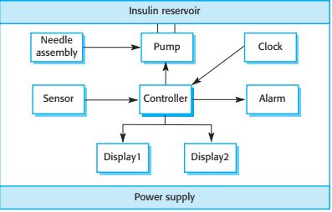
Insulin pump hardware architecture

Slide 42
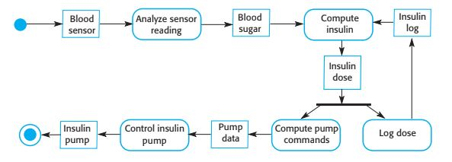
Activity model of the insulin pump

Slide 43
Contd..
Figure shows the hardware components and organization of the insulin pump.
To understand the examples in this book, all you need to know is that the blood sensor measures the electrical conductivity of the blood under different conditions and that these values can be related to the blood sugar level.
The insulin pump delivers one unit of insulin in response to a single pulse from a controller.
Therefore, to deliver 10 units of insulin, the controller sends 10 pulses to the pump. Figure is a Unified Modeling

Slide 44
Contd..
Figure is a Unified Modeling Language (UML) activity model that illustrates how the software transforms an input blood sugar level to a sequence of commands that drive the insulin pump.
Clearly, this is a safety-critical system. If the pump fails to operate or does not operate correctly, then the user’s health may be damaged or they may fall into a coma because their blood sugar levels are too high or too low.
This system must therefore meet two essential high-level requirements:
1. The system shall be available to deliver insulin when required.
2. The system shall perform reliably and deliver the correct amount of insulin to counteract the current level of blood sugar.

Slide 45
A patient information system for mental health care
A patient information system to support mental health care (the Mentcare system) is a medical information system that maintains information about patients suffering from mental health problems and the treatments that they have received.
Most mental health patients do not require dedicated hospital treatment but need to attend specialist clinics regularly where they can meet a doctor who has detailed knowledge of their problems.
To make it easier for patients to attend, these clinics are not just run in hospitals.
They may also be held in local medical practices or community centers.

Slide 46
Contd..
The Mentcare system (Figure 1.6) is a patient information system that is intended for use in clinics.
It makes use of a centralized database of patient information but has also been designed to run on a laptop, so that it may be accessed and used from sites that do not have secure network connectivity.
When the local systems have secure network access, they use patient information in the database, but they can download and use local copies of patient records when they are disconnected.
The system is not a complete medical records system and so does not maintain information about other medica conditions.
However, it may interact and exchange data with other clinical information systems.This system has two purposes:

Slide 47
Contd..
1. To generate management information that allows health service managers to assess performance against local and government targets.
2. To provide medical staff with timely information to support the treatment of patients.
Patients who suffer from mental health problems are sometimes irrational and disorganized so may miss appointments, deliberately or accidentally lose prescriptions and medication, forget instructions and make unreasonable demands on medical staff.
They may drop in on clinics unexpectedly. In a minority of cases, they may be a danger to themselves or to other people.
They may regularly change address or may be homeless on a long-term or short-term basis. Where patients are dangerous, they may need to be “sectioned”—that is, confined to a secure hospital for treatment and observation.

Slide 48
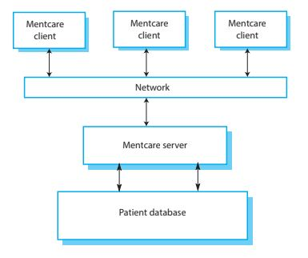
The organization of the Mentcare system

Slide 49
The key features of the system are
1. Individual care management Clinics can create records for patients, edit the information in the system, view patient history, and so on. The system supports data summaries so that doctors who have not previously met a patient can quickly learn about the key problems and treatments that have been prescribed.
2. Patient monitoring The system regularly monitors the records of patients that are involved in treatment and issues warnings if possible problems are detected. Therefore, if a patient has not seen a doctor for some time, a warning may be issued. One of the most important elements of the monitoring system is to keep track of patients who have been sectioned and to ensure that the legally required checks are carried out at the right time.

Slide 50
Contd..
3. Administrative reporting The system generates monthly management reports showing the number of patients treated at each clinic, the number of patients who have entered and left the care system, the number of patients sectioned, the drugs prescribed and their costs, etc.

Slide 51
A wilderness weather station
To help monitor climate change and to improve the accuracy of weather forecasts in remote areas, the government of a country with large areas of wilderness decides to deploy several hundred weather stations in remote areas.
These weather stations collect data from a set of instruments that measure temperature and pressure, sunshine, rainfall, wind speed and wind direction. Wilderness weather stations are part of a larger system (Figure 1.7), which is a weather information system that collects data from weather stations and makes it available to other systems for processing. The systems in Figure 1.7 are:

Slide 52
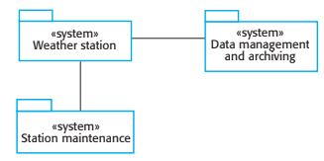
The weather station’s environment

Slide 53
Contd..
1. The weather station system: This system is responsible for collecting weather data, carrying out some initial data processing, and transmitting it to the data management system.
2. The data management and archiving system :This system collects the data from all of the wilderness weather stations, carries out data processing and analysis, and archives the data in a form that can be retrieved by other systems, such as weather forecasting systems.
3. The station maintenance system: This system can communicate by satellite with all wilderness weather stations to monitor the health of these systems and provide reports of problems. It can update the embedded software in these systems. In the event of system problems, this system can also be used to remotely control the weather station.

Slide 54
Contd..
In Figure 1.7, have used the UML package symbol to indicate that each system is a collection of components and the separate systems are identified using the UML stereotype «system».
The associations between the packages indicate there is an exchange of information but, at this stage.
The weather stations include instruments that measure weather parameters such as wind speed and direction, ground and air temperatures, barometric pressure, and rainfall over a 24-hour period.
Each of these instruments is controlled by a software system that takes parameter readings periodically and manages the data collected from the instruments.

Slide 55
Contd..
The weather station system operates by collecting weather observations at frequent intervals; for example, temperatures are measured every minute.
However, because the bandwidth to the satellite is relatively narrow, the weather station carries out some local processing and aggregation of the data.
It then transmits this aggregated data when requested by the data collection system.
If it is impossible to make a connection, then the weather station maintains the data locally until communication can be resumed.

Slide 56
Contd..
The station software is therefore not just concerned with data collection. It must also:
1. Monitor the instruments, power. and communication hardware and report faults to the management system.
2. Manage the system power, ensuring that batteries are charged whenever the environmental conditions permit but also that generators are shut down in potentially damaging weather conditions, such as high wind.
3. Allow for dynamic reconfiguration where parts of the software and replace with new versions and where backup instruments are switched into the system in the event of system failure.

Slide 57
A digital learning environment for schools
A digital learning environment is a framework in which a set of general-purpose and specially designed tools for learning may be embedded, plus a set of applications that are geared to the needs of the learners using the system.
The framework provides general services such as an authentication service, synchronous and asynchronous communication services, and a storage service. The tools included in each version of the environment are chosen by teachers and learners to suit their specific needs.
These can be general applications such as spreadsheets, learning management applications such as a Virtual Learning Environment(VLE) to manage homework submission and assessment, games, and simulations. They may also include specific content, such as content about the American Civil War and applications to view and annotate that content.

Slide 58
Contd..
Figure 1.8 is a high-level architectural model of a digital learning environment (iLearn) that was designed for use in schools for students from 3 to 18 years of age.
The approach adopted is that this is a distributed system in which all components of the environment are services that can be accessed from anywhere on the Internet.
There is no requirement that all of the learning tools are gathered together in one place.

Slide 59
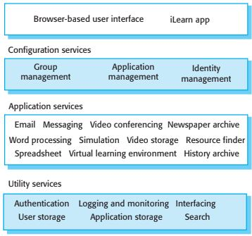
The architecture of a digital learning environment (iLearn)

Slide 60
Contd..
The system is a service-oriented system with all system components considered to be a replaceable service. There are three types of service in the system:
1. Utility services that provide basic application-independent functionality and that may be used by other services in the system. Utility services are usually developed or adapted specifically for this system.
2. Application services that provide specific applications such as email, conferencing, photo sharing, etc., and access to specific educational content such as scientific films or historical resources. Application services are external services that are either specifically purchased for the system or are available freely over the Internet.
3. Configuration services that are used to adapt the environment with a specific set of application services and to define how services are shared between students, teachers, and their parents.

Slide 61
Contd..
the system has to support two levels of service integration:
Integrated services are services that offer an API (application programming interface) and that can be accessed by other services through that API.
Direct service-to-service communication is therefore possible. An authentication service is an example of an integrated service. Rather than use their own authentication mechanisms, an authentication service may be called on by other services
to authenticate users. If users are already authenticated, then the authentication service may pass authentication information directly to another service, via an API, with no need for users to reauthenticate themselves.
2. Independent services are services that are simply accessed through a browser interface and that operate independently of other services. Information can only be shared with other services through explicit user actions such as copy and paste; reauthentication may be required for each independent service.

Slide 62
Software process models
1. The waterfall model This takes the fundamental process activities of specification, development, validation, and evolution and represents them as separate process phases such as requirements specification, software design, implementation, and testing.
2. Incremental development This approach interleaves the activities of specification, development, and validation. The system is developed as a series of versions(increments), with each version adding functionality to the previous version.
3. Integration and configuration This approach relies on the availability of reusable components or systems. The system development process focuses on configuring these components for use in a new setting and integrating them into a system.

Slide 63
Waterfall model
The first published model of the software development process was derived from engineering process models used in large military systems engineering (Royce1970).
It presents the software development process as a number of stages, as shown in Figure 2.1. Because of the cascade from one phase to another, this model is known as the waterfall model or software life cycle. The waterfall model is an example of a plan-driven process.
In principle at least, you plan and schedule all of the process activities before starting software development.

Slide 64
The waterfall model
The stages of the waterfall model directly reflect the fundamental software development activities:
1. Requirements analysis and definition The system’s services, constraints, and goals are established by consultation with system users. They are then defined in detail and serve as a system specification.
2. System and software design The systems design process allocates the requirements to either hardware or software systems. It establishes an overall system architecture. Software design involves identifying and describing the fundamental software system abstractions and their relationships.
3. Implementation and unit testing During this stage, the software design is realized as a set of programs or program units. Unit testing involves verifying that each unit meets its specification.

Slide 65
Incremental development
Incremental development is based on the idea of developing an initial implementation, getting feedback from users and others, and evolving the software through several versions until the required system has been developed (Figure 2.2). Specification, development, and validation activities are interleaved rather than separate, with rapid feedback across activities.

Slide 66
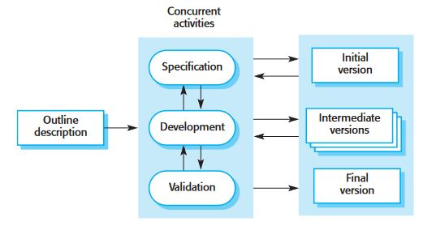
Contd..

Slide 67
Contd..
Incremental development in some form is now the most common approach for the development of application systems and software products.
This approach can be either plan-driven, agile or, more usually, a mixture of these approaches.
In a plan-driven approach, the system increments are identified in advance; if an agile approach is adopted, the early increments are identified, but the development of later increments depends on progress and customer priorities.

Slide 68
Contd..
Incremental software development, which is a fundamental part of agile development methods, is better than a waterfall approach for systems whose requirements are likely to change during the development process.
This is the case for most business systems and software products. Incremental development reflects the way that we solve problems.
We rarely work out a complete problem solution in advance but move toward a solution in a series of steps, back- tracking when we realize that we have made a mistake.
By developing the software incrementally, it is cheaper and easier to make changes in the software as it is being developed.

Slide 69
Contd..
Incremental development has three major advantages over the waterfall model:
1. The cost of implementing requirements changes is reduced. The amount of analysis and documentation that has to be redone is significantly less than is required with the waterfall model.
2. It is easier to get customer feedback on the development work that has been done. Customers can comment on demonstrations of the software and see how much has been implemented. Customers find it difficult to judge progress from software design documents.
3. Early delivery and deployment of useful software to the customer is possible, even if all of the functionality has not been included. Customers are able to use and gain value from the software earlier than is possible with a waterfall process.

Slide 70
Integration and configuration
In the majority of software projects, there is some software reuse. This often happens informally when people working on the project know of or search for code that is similar to what is required. They look for these, modify them as needed, and integrate them with the new code that they have developed.
Three types of software components are frequently reused:
1. Stand-alone application systems that are configured for use in a particular environment. These systems are general-purpose systems that have many features, but they have to be adapted for use in a specific application.
2. Collections of objects that are developed as a component or as a package to be integrated with a component framework such as the Java Spring framework (Wheeler and White 2013).
3. Web services that are developed according to service standards and that are available for remote invocation over the Internet.

Slide 71
Contd..
Figure shows a general process model for reuse-based development, based on integration and configuration. The stages in this process are:
1. Requirements specification The initial requirements for the system are proposed. These do not have to be elaborated in detail but should include brief descriptions of essential requirements and desirable system features.
2. Software discovery and evaluation Given an outline of the software requirements, a search is made for components and systems that provide the functionality required. Candidate components and systems are evaluated .

Slide 72
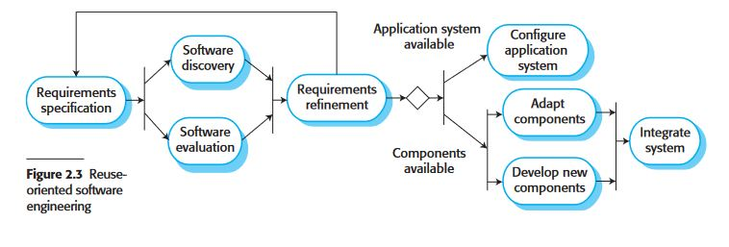
Contd..

Slide 73
Contd..
3. Requirements refinement: During this stage, the requirements are refined using information about the reusable components and applications that have been discovered. The requirements are modified to reflect the available components, and the system specification is re-defined. Where modifications are impossible, the component analysis activity may be reentered to search for alternative solutions.
4. Application system: configuration If an off-the-shelf application system that meets the requirements is available, it may then be configured for use to create the new system.
5. Component adaptation and integration :If there is no off-the-shelf system, individual reusable components may be modified and new components developed. These are then integrated to create the system.

Slide 74
Process Activities
Real software processes are interleaved sequences of technical, collaborative, and managerial activities with the overall goal of specifying, designing, implementing, and testing a software system. Generally, processes are now tool-supported.
This means that software developers may use a range of software tools to help them, such as requirements management systems, design model editors, program editors, automated testing tools, and debuggers.

Slide 75
Contd..1. Software specification
Software specification or requirements engineering is the process of understanding and defining what services are required from the system and identifying the constraints on the system’s operation and development.
Requirements engineering is a particularly critical stage of the software process, as mistakes made at this stage inevitably lead to later problems in the system design and implementation.
Before the requirements engineering process starts, a company may carry out a feasibility or marketing study to assess whether or not there is a need or a market for the software and whether or not it is technically and financially realistic to develop the software required.
Feasibility studies are short-term, relatively cheap studies that inform the decision of whether or not to go ahead with a more detailed analysis.

Slide 76
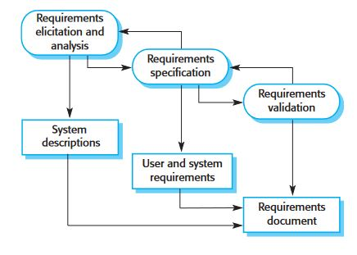
The requirements engineering process

Slide 77
Contd..
The requirements engineering process (Figure ) aims to produce an agreed requirements document that specifies a system satisfying stakeholder requirements. Requirements are usually presented at two levels of detail.
End-users and customers need a high-level statement of the requirements; system developers need a more detailed system specification.

Slide 78
There are three main activities in the requirements engineering process:
1. Requirements elicitation and analysis: This is the process of deriving the system requirements through observation of existing systems, discussions with potential users and procurers, task analysis, and so on. This may involve the development of one or more system models and prototypes. These help you understand the system to be specified.
2. Requirements specification: Requirements specification is the activity of translating the information gathered during requirements analysis into a document that defines a set of requirements. Two types of requirements may be included in this document. User requirements are abstract statements of the system requirements for the customer and end-user of the system; system requirements are a more detailed description of the functionality to be provided.
3. Requirements validation: This activity checks the requirements for realism, consistency, and completeness. During this process, errors in the requirements document are inevitably discovered. It must then be modified to correct these problems.

Slide 79
2. Software design and implementation
The implementation stage of software development is the process of developing an executable system for delivery to the customer.
Sometimes this involves separate activities of software design and programming.
However, if an agile approach to development is used, design and implementation are interleaved, with no formal design documents produced during the process.
Of course, the software is still designed, but the design is recorded informally on whiteboards and programmer’s notebooks.

Slide 80
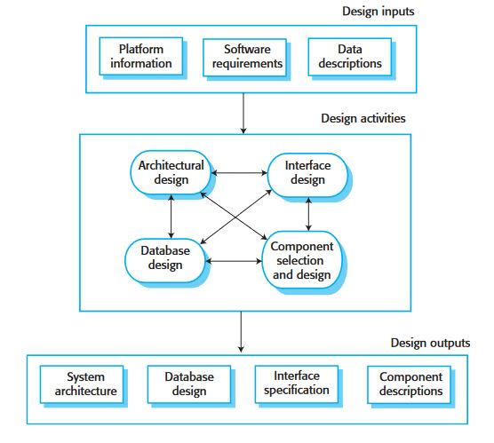
A general model of the design process

Slide 81
Contd..
(Figure ) is an abstract model of the design process showing the inputs to the design process, process activities, and the process outputs.
The design process activities are both interleaved and interdependent. New information about the design is constantly being generated, and this affects previous design decisions. Design rework is therefore inevitable.
Most software interfaces with other software systems. These other systems include the operating system, database, middleware, and other application systems.
These make up the “software platform,’ the environment in which the software will execute.
Information about this platform is an essential input to the design process, as designers must decide how best to integrate it with its environment. If the system is to process existing data, then the description of that data may be included in the platform specification.
Otherwise, the data description must be an input to the design process so that the system data organization can be defined.

Slide 82
Four activities are:
1. Architectural design: where you identify the overall structure of the system, the principal components (sometimes called subsystems or modules), their relation- ships, and how they are distributed.
2. Database design: where you design the system data structures and how these are to be represented in a database. Again, the work here depends on whether an existing database is to be reused or a new database is to be created.
3. Interface design: where you define the interfaces between system components. This interface specification must be unambiguous. With a precise interface, a component may be used by other components without them having to know how it is implemented. Once interface specifications are agreed, the components can be separately designed and developed.
4. Component selection and design: where you search for reusable components and, if no suitable components are available, design new software components. The design at this stage may be a simple component description with the implementation details left to the programmer. Alternatively, it may be a list of changes to be made to a reusable component or a detailed design model expressed in the UML. The design model may then be used to automatically generate an implementation.

Slide 83
3. Software validation
Software validation or, more generally, verification and validation (V & V) is intended to show that a system both conforms to its specification and meets the expectations of the system customer. Program testing, where the system is executed using simulated test data, is the principal validation technique.
Validation may also involve checking processes, such as inspections and reviews, at each stage of the software process from user requirements definition to program development.
However, most V & V time and effort is spent on program testing.

Slide 84
Contd..
Except for small programs, systems should not be tested as a single, monolithic unit. Figure shows a three-stage testing process in which system components are individually tested, then the integrated system is tested.
For custom software, customer testing involves testing the system with real customer data.
For products that are sold as applications, customer testing is sometimes called beta testing where selected users try out and comment on the software.

Slide 85
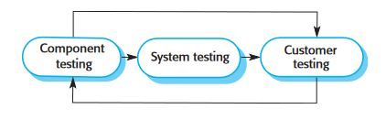
Stages of testing

Slide 86
the stages in the testing process are(fig)
1. Component testing The components making up the system are tested by the people developing the system. Each component is tested independently, without other system components. Components may be simple entities such as functions or object classes or may be coherent groupings of these entities.
2.System testing System components are integrated to create a complete system. This process is concerned with finding errors that result from unanticipated interactions between components and component interface problems. It is also concerned with showing that the system meets its functional and non-functional requirements, and testing the emergent system properties.

Slide 87
Contd..
3. Customer testing This is the final stage in the testing process before the system is accepted for operational use. The system is tested by the system customer (or potential customer) rather than with simulated test data. For custom-built software, customer testing may reveal errors and omissions in the system requirements definition, because the real data exercise the system in different ways from the test data.

Slide 88
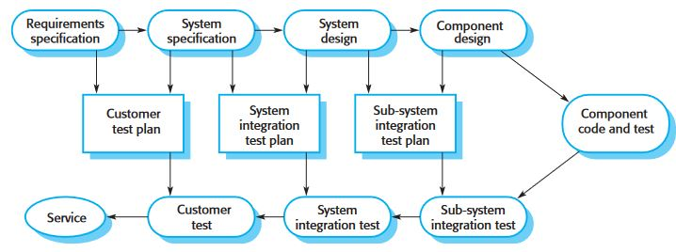
Testing phases in a plan-driven software process

Slide 89
Contd..
Figure illustrates how test plans are the link between testing and development activities.
This is sometimes called the V-model of development (turn it on its side to see the V). The V-model shows the software validation activities that correspond to each stage of the waterfall process model.
When a system is to be marketed as a software product, a testing process called beta testing is often used.
Beta testing involves delivering a system to a number of potential customers who agree to use that system. They report problems to the system developers.
This exposes the product to real use and detects errors that may not have been anticipated by the product developers. After this feedback, the software product may be modified and released for further beta testing or general sale.

Slide 90
4.Software evolution
The flexibility of software is one of the main reasons why more and more software is being incorporated into large, complex systems. Once a decision has been made to manufacture hardware, it is very expensive to make changes to the hardware design.
However, changes can be made to software at any time during or after the system development.
Even extensive changes are still much cheaper than corresponding changes to system hardware.

Slide 91
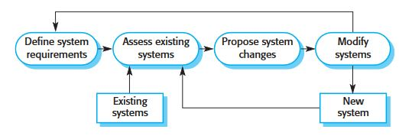
Software system evolution

Slide 92
Contd..
Historically, there has always been a split between the process of software development and the process of software evolution (software maintenance).
People think of software development as a creative activity in which a software system is developed from an initial concept through to a working system.
However, they sometimes think of software maintenance as dull and uninteresting.
They think that software maintenance is less interesting and challenging than original soft-ware development.
This distinction between development and maintenance is increasingly irrelevant.
Very few software systems are completely new systems, and it makes much more sense to see development and maintenance as a continuum. Rather than two separate processes, it is more realistic to think of software engineering as an evolutionary process (Figure) where software is continually changed over its lifetime in response to changing requirements and customer needs

Slide 93
Coping with change
Change is inevitable in all large software projects. The system requirements change as businesses respond to external pressures, competition, and changed management priorities.
As new technologies become available, new approaches to design and implementation become possible.
Therefore whatever software process model is used, it is essential that it can accommodate changes to the software being developed.

Slide 94
approaches used to reduce the costs of rework:
1. Change anticipation, where the software process includes activities that can anticipate or predict possible changes before significant rework is required. For example, a prototype system may be developed to show some key features of the system to customers. They can experiment with the prototype and refine their requirements before committing to high software production costs.
2. Change tolerance, where the process and software are designed so that changes can be easily made to the system. This normally involves some form of incremental development. Proposed changes may be implemented in increments that have not yet been developed. If this is impossible, then only a single increment
(a small part of the system) may have to be altered to incorporate the change.

Slide 95
two ways of coping with change and changing system requirements:
1. System prototyping, where a version of the system or part of the system is developed quickly to check the customer’s requirements and the feasibility of design decisions. This is a method of change anticipation as it allows users to experiment with the system before delivery and so refine their requirements. The number of requirements change proposals made after delivery is therefore likely to be reduced.
2. Incremental delivery, where system increments are delivered to the customer for comment and experimentation. This supports both change avoidance and change tolerance. It avoids the premature commitment to requirements for the whole system and allows changes to be incorporated into later increments at relatively low cost.

Slide 96
1. Prototyping
A prototype is an early version of a software system that is used to demonstrate concepts, try out design options, and find out more about the problem and its possible solutions.
Rapid, iterative development of the prototype is essential so that costs are controlled and system stakeholders can experiment with the prototype early in the software process.
A software prototype can be used in a software development process to help anticipate changes that may be required:
1. In the requirements engineering process, a prototype can help with the elicitation and validation of system requirements.
2. In the system design process, a prototype can be used to explore software solutions and in the development of a user interface for the system.

Slide 97
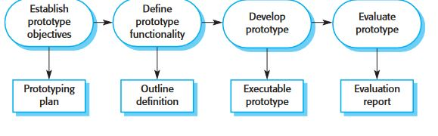
Prototype development

Slide 98
Contd..
In Figure The objectives of prototyping should be made explicit from the start of the process. These may be to develop the user interface, to develop a system to validate functional system requirements, or to develop a system to demonstrate the application to managers.
The same prototype usually cannot meet all objectives. If the objectives are left unstated, management or end-users may misunderstand the function of the prototype. Consequently, they may not get the benefits that they expected from the prototype development.

Slide 99
Contd..
The next stage in the process is to decide what to put into and, perhaps more importantly, what to leave out of the prototype system. To reduce prototyping costs and accelerate the delivery schedule, you may leave some functionality out of the prototype.
You may decide to relax non-functional requirements such as response time and memory utilization. Error handling and management may be ignored unless the objective of the prototype is to establish a user interface. Standards of reliability and program quality may be reduced.

Slide 100
Contd..
The final stage of the process is prototype evaluation. Provision must be made during this stage for user training, and the prototype objectives should be used to derive a plan for evaluation.
Potential users need time to become comfortable with a new system and to settle into a normal pattern of usage.
Once they are using the system normally, they then discover requirements errors and omissions.

Slide 101
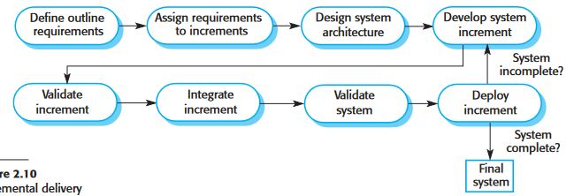
2. Incremental delivery

Slide 102
Contd..
Incremental delivery (Figure 2.10) is an approach to software development where some of the developed increments are delivered to the customer and deployed for use in their working environment.
In an incremental delivery process, customers define which of the services are most important and which are least important to them.
A number of delivery increments are then defined, with each increment providing a subset of the system functionality.
The allocation of services to increments depends on the service priority, with the highest priority services implemented and delivered first.

Slide 103
Contd..
Once the system increments have been identified, the requirements for the services to be delivered in the first increment are defined in detail and that increment is developed.
During development, further requirements analysis for later increments can take place, but requirements changes for the current increment are not accepted.
Once an increment is completed and delivered, it is installed in the customer’s normal working environment.
They can experiment with the system, and this helps them clarify their requirements for later system increments.
As new increments are completed, they are integrated with existing increments so that system functionality improves with each delivered increment.

Slide 104
Incremental delivery has a number of advantages:
1. Customers can use the early increments as prototypes and gain experience that informs their requirements for later system increments. Unlike prototypes, these are part of the real system, so there is no relearning when the complete system is available.
2. Customers do not have to wait until the entire system is delivered before they can gain value from it. The first increment satisfies their most critical requirements, so they can use the software immediately.
3. The process maintains the benefits of incremental development in that it should be relatively easy to incorporate changes into the system.
4. As the highest priority services are delivered first and later increments then integrated, the most important system services receive the most testing.

Slide 105
Boehm’s spiral model
A risk-driven software process framework (the spiral model) was proposed by Boehm (1988).
This is shown in Figure . Here, the software process is represented as a spiral, rather than a sequence of activities with some backtracking from one activity to another.
Each loop in the spiral represents a phase of the software process. Thus, the innermost loop might be concerned with system feasibility, the next loop with requirements definition, the next loop with system design, and so on.

Slide 106
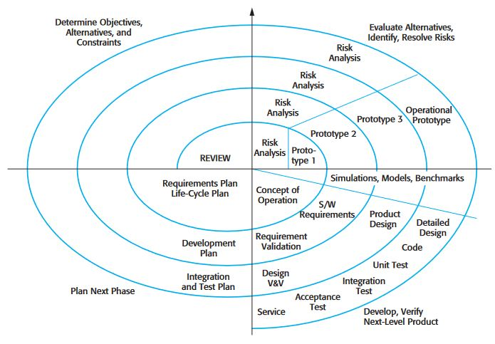
Boehm’s spiral model

Slide 107
Contd..
Each loo
1. Objective setting :Specific objectives for that phase of the project are defined. Constraints on the process and the product are identified and a detailed management plan is drawn up. Project risks are identified. Alternative strategies, depending on these risks, may be planned.
2. Risk assessment and reduction: For each of the identified project risks, a detailed analysis is carried out. Steps are taken to reduce the risk. For example, if there is a risk that the requirements are inappropriate, a prototype system may be developed in the spiral is split into four sectors:

Slide 108
Contd..
3. Development and validation After risk evaluation, a development model for the system is chosen. For example, throwaway prototyping may be the best development approach if user interface risks are dominant. If safety risks are the main consideration, development based on formal transformations may be the most appropriate process, and so on. If the main identified risk is sub-system integration, the waterfall model may be the best development model to use.
4. Planning The project is reviewed and a decision made whether to continue with a further loop of the spiral. If it is decided to continue, plans are drawn up for the next phase of the project.

Slide 109
AGILE SOFTWARE DEVELOPMENT
Businesses now operate in a global, rapidly changing environment. They have to respond to new opportunities and markets, changing economic conditions and the emergence of competing products and services
Software is part of almost all business operations, so new software has to be developed quickly to take advantage of new opportunities and to respond to competitive pressure
Rapid software development and delivery is therefore the most critical requirement for most business systems
Rapid software development became known as agile development or agile methods

Slide 110
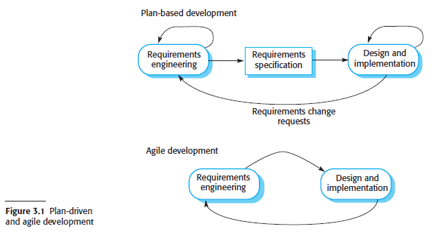
Faster software development really took off in the late 1990s with the development of the idea of “agile methods” such as Extreme Programming (Beck 1999), Scrum (Schwaber and Beedle 2001), and DSDM- Dynamic System Development Methods (Stapleton 2003).

Slide 111
These agile methods are designed to produce useful software quickly. All of the agile methods that have been proposed share a number of common characteristics
The processes of specification, design and implementation are interleaved. There is no detailed system specification, and design documentation is minimized or generated automatically by the programming environment used to implement the system. The user requirements document is an outline definition of the most important characteristics of the system.
The system is developed in a series of increments. End-users and other system stakeholders are involved in specifying and evaluating each increment. They may propose changes to the software and new requirements that should be implemented in a later version of the system.
Extensive tool support is used to support the development process. Tools that may be used include automated testing tools, tools to support configuration management, and system integration and tools to automate user interface production

Slide 112
3.1 Agile methods
plan-driven approach was developed for software developed by large teams, working for different companies. Plan-driven approaches involve a significant overhead in planning, designing, and documenting the system. This overhead is justified when the work of multiple development teams has to be coordinated, when the system is a critical system and when many different people will be involved in maintaining the software over its lifetime.
when this heavyweight, plan-driven development approach is applied to small and medium-sized business systems, the overhead involved is so large that it dominates the software development process.
Dissatisfaction with these heavyweight approaches to software engineering led to the development of agile methods in the late 1990s

Slide 113
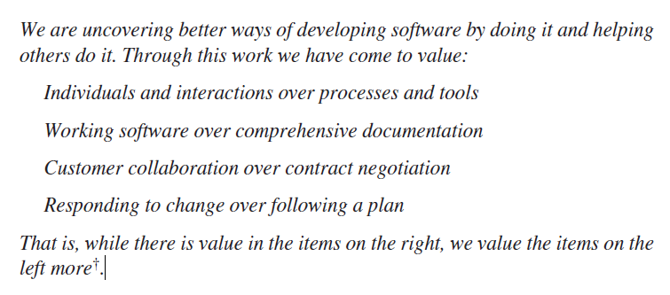
The philosophy behind agile methods is reflected in the agile manifesto (http://agilemanifesto.org) issued by the leading developers of these methods. This manifesto states

Slide 114
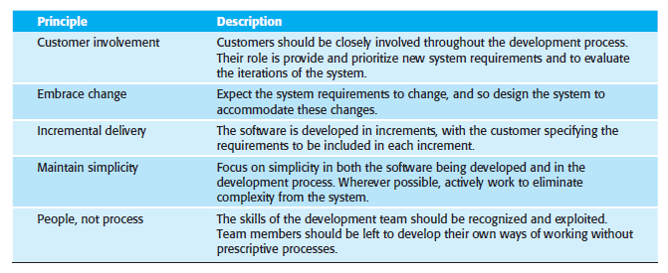
The methods are based on different agile processes but they share a set of principles, based on the agile manifesto, and so they have much in common
Figure 3.2 The principles of agile methods

Slide 115
Agile methods have been particularly successful for two kinds of system development.
Product development where a software company is developing a small or medium-sized product for sale. Virtually all software products and apps are now developed using an agile approach.
Custom system development within an organization, where there is clear commitment from the customer to become involved in the development process and where there are few external stakeholders and regulations that affect the software.

Slide 116
3.2 Agile development techniques
The most significant approach to changing software development culture was the development of Extreme Programming (XP)
The name was coined by Kent Beck (Beck 1998) because the approach was developed by pushing recognized good practice, such as iterative development, to “extreme” levels
Extreme programming was controversial as it introduced a number of agile practices that were quite different from the development practice of that time. These practices are summarized in below figure

Slide 117
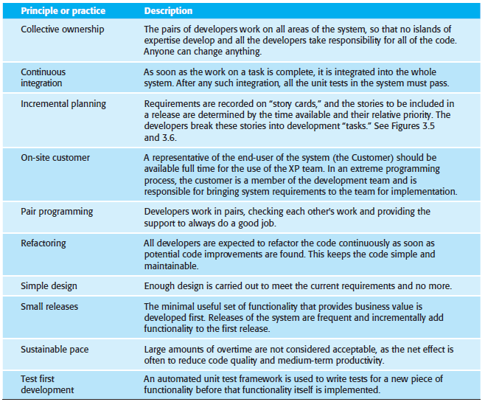

Slide 118
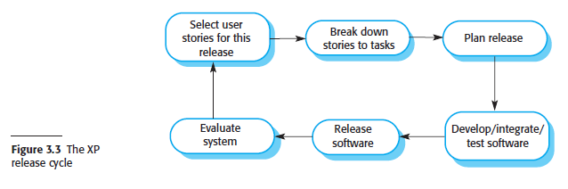

Slide 119
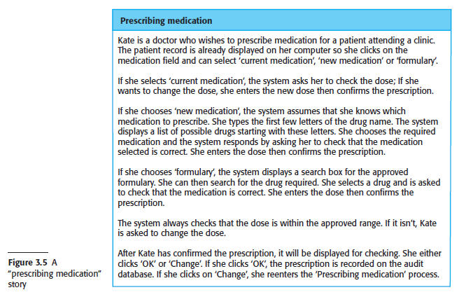
3.2.1 User stories
The idea of “user stories” was developed where a user story is a scenario of use that might be experienced by a system user and they develop a “story card” that briefly describes a story that encapsulates the customer needs.

Slide 120
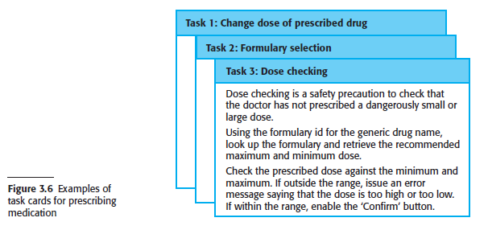

Slide 121
3.2.2 Refactoring
Refactoring (Fowler et al. 1999) means that the programming team look for possible improvements to the software and implements them immediately
Refactoring improves the software structure and readability and so avoids the structural deterioration that naturally occurs when software is changed
Examples of refactoring include the reorganization of a class hierarchy to remove duplicate code, the tidying up and renaming of attributes and methods, and the replacement of similar code sections, with calls to methods defined in a program library.

Slide 122
3.2.3 Test-first development
The important differences between incremental development and plan-driven development is in the way that the system is tested
Extreme Programming developed a new approach to program testing to address the difficulties of testing without a specification. Testing is automated and is central to the development process, and development cannot proceed until all tests have been successfully executed
The key features of testing in XP are:
1. test-first development,
2. incremental test development from scenarios,
3. user involvement in the test development and validation, and
4. the use of automated testing frameworks.

Slide 123
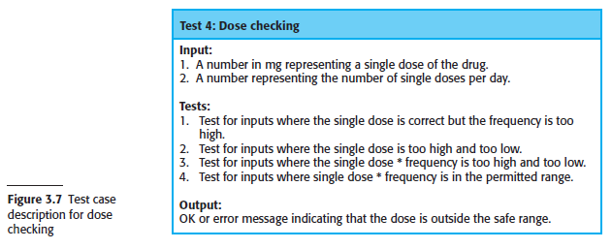
XP’s test-first philosophy has now evolved into more general test-driven development techniques (Jeffries and Melnik 2007). Instead of writing code and then writing tests for that code, you write the tests before you write the code

Slide 124
3.2.4 Pair programming
The programming pair sits at the same computer to develop the software
The same pair do not always program together. Rather, pairs are created dynamically so that all team members work with each other during the development process.
Pair programming has a number of advantages
It supports the idea of collective ownership and responsibility for the system
It acts as an informal review process because each line of code is looked at by at least two people
It encourages refactoring to improve the software structure

Slide 125
You might think that pair programming would be less efficient than individual programming. In a given time, a pair of developers would produce half as much code as two individuals working alone. Many companies that have adopted agile methods are suspicious of pair programming and do not use it.
Other companies mix pair and individual programming with an experienced programmer working with a less experienced colleague when they have problems.

Slide 126
3.3 Agile project management
In any software business, managers need to know what is going on and whether or not a project is likely to meet its objectives and deliver the software on time with the proposed budget
Managers draw up a plan for the project showing what should be delivered, when it should be delivered, and who will work on the development of the project deliverables
The Scrum agile method was developed to provide a framework for organizing agile projects and, to some extent at least, provide external visibility of what is going on
The developers of Scrum wished to make clear that Scrum was not a method for project management in the conventional sense,
So, they deliberately invented new terminology, such as Scrum Master, which replaced names such as project manager

Slide 127
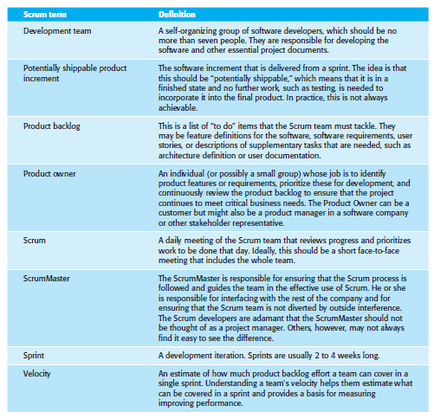

Slide 128
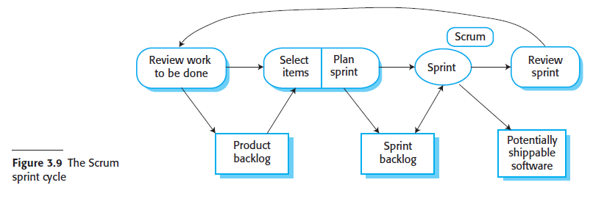

Slide 129
The things that users like about the Scrum method are:
The product is broken down into a set of manageable and understandable chunks that stakeholders can relate to
Unstable requirements do not hold up progress
The whole team has visibility of everything, and consequently team communication and morale are improved
Customers see on-time delivery of increments and gain feedback on how the product works. They are not faced with last-minute surprises when a team announces that software will not be delivered as expected
Trust between customers and developers is established, and a positive culture is created in which everyone expects the project to succeed

Slide 130
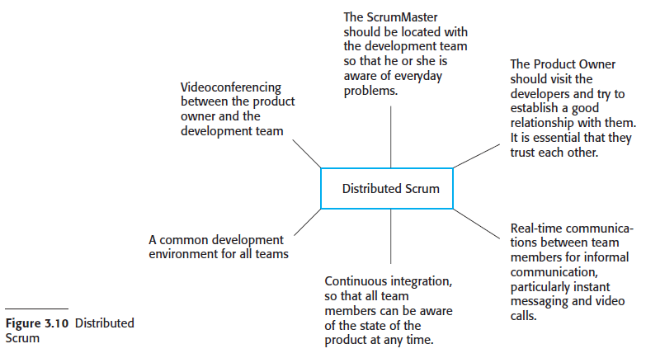

Slide 131
3.4 Scaling agile methods
Agile methods were developed for use by small programming teams that could work together in the same room and communicate informally
Scaling agile methods has closely related facets:
Scaling up these methods to handle the development of large systems that are too big to be developed by a single small team.
Scaling out these methods from specialized development teams to more widespread use in a large company that has many years of software development experience.

Slide 132
3.4.1 Practical problems with agile methods
Agile methods may not be suitable for other types of software development, such as embedded systems engineering or the development of large and complex systems.
using an agile approach presents a number of problems.
The informality of agile development is incompatible with the legal approach to contract definition that is commonly used in large companies.
Agile methods are most appropriate for new software development rather than for software maintenance. Yet the majority of software costs in large companies come from maintaining their existing software systems.
Agile methods are designed for small co-located teams, yet much software development now involves worldwide distributed teams.

Slide 133
Maintenance involves a custom system that must be changed in response to new business requirements, there is no clear consensus on the suitability of agile methods for software maintenance.
Three types of problems can arise:
■ lack of product documentation
■ keeping customers involved
■ development team continuity

Slide 134
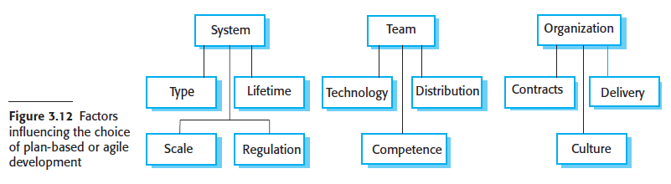
3.4.2 Agile and plan-driven methods
A fundamental requirement of scaling agile methods is to integrate them with plan driven approaches.

Slide 135
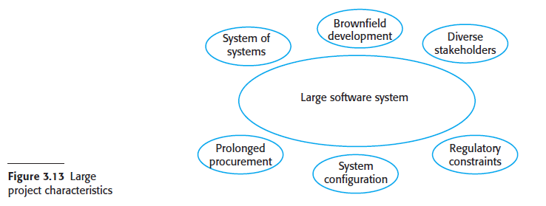
3.4.3 Agile methods for large systems
Agile methods have to evolve to be used for large-scale software development. The fundamental reason for this is that large-scale software systems are much more complex and difficult to understand and manage than small-scale systems or software products.
Six principal factors contribute to this complexity:

Slide 136
3.4.4 Agile methods across organizations
It can be difficult to introduce agile methods into large companies for a number of
reasons:
Project managers who do not have experience of agile methods may be reluctant to accept the risk of a new approach, as they do not know how this will affect their particular projects.
Large organizations often have quality procedures and standards that all projects are expected to follow, and, because of their bureaucratic nature, these are likely to be incompatible with agile methods. Sometimes, these are supported by software tools (e.g., requirements management tools), and the use of these tools is mandated for all projects.
Agile methods seem to work best when team members have a relatively high skill level. However, within large organizations, there are likely to be a wide range of skills and abilities, and people with lower skill levels may not be effective team members in agile processes.
There may be cultural resistance to agile methods, especially in those organizations that have a long history of using conventional systems engineering processes.

